Slide 1
Notes:
1

Slide 2

Improving I/O Performance in HPC Using Guided Prefetching and Non-Volatile Memory Devices
Candidate: Giuseppe Congiu
Advisors: Prof. Dr.-Ing. André Brinkmann
Dr. Sai Narasimhamurthy
The research leading to these results has received funding from the European
Community's Seventh Framework Programme (FP7/2007-2013)
Notes:
2

Slide 3
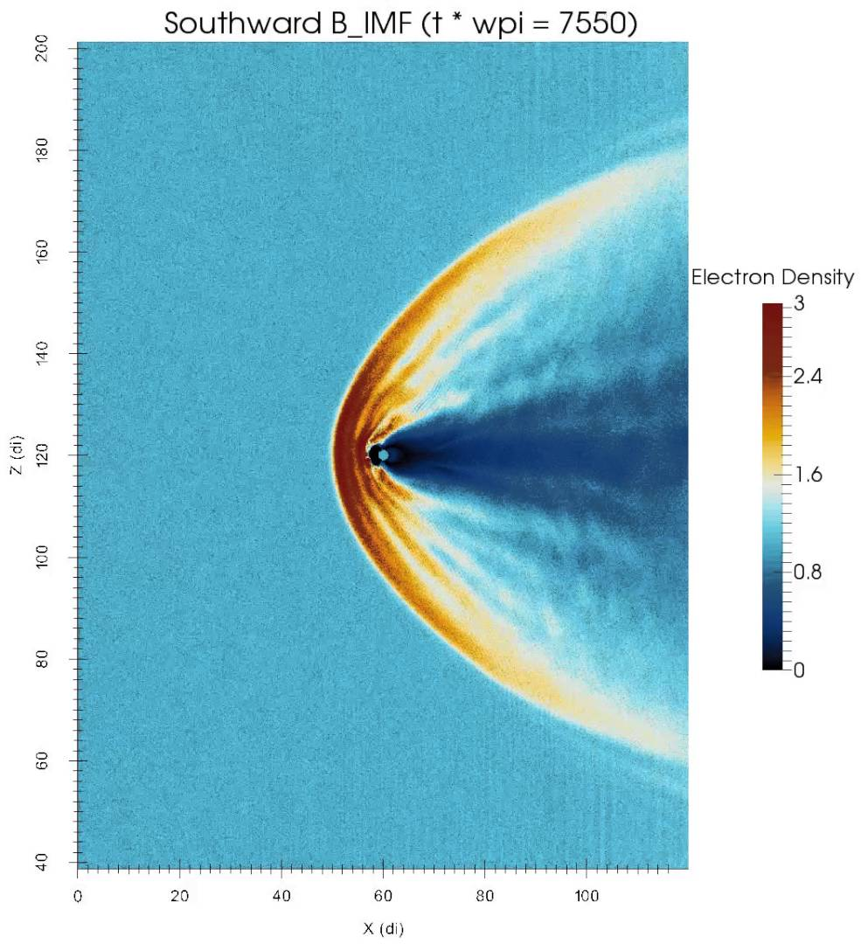
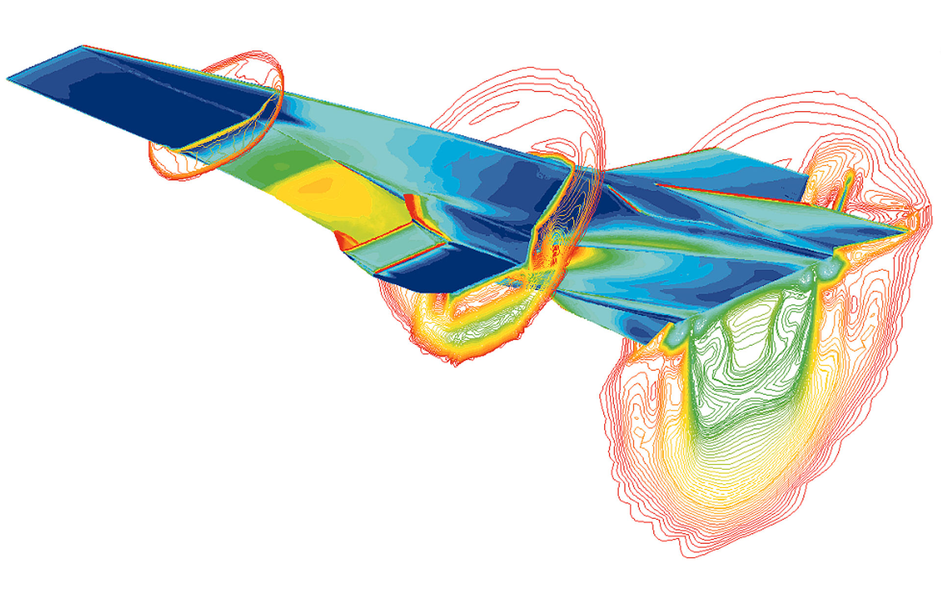


Driving Science with HPC
High Performance Computing
Hyper-X Scramjet Vehicle
Simulation
iPIC3D Particle-in-Cell Space & Fusion Plasma
Universe Scale
Simulation
Human Brain Simulation
Notes:
Nowadays high performance computing is ubiquitous. Many branches of science today use HPC for their research. Some example include CFD codes used by aircraft manufacturer to understand how air flows on the wings and body of aircrafts, at the same time reducing the number of expensive prototypes and wind tunnel tests; the particle in cell simulation to study how plasma propagates and interact with the magnetic field of the earth and other cosmic bodies; the study of universe and even of the human brain works. All these applications today run on supercomputers and operate on very large datasets that often do not fit into system memory and have to be stored in a parallel file system. This is one of the major concern for performance.

Slide 4
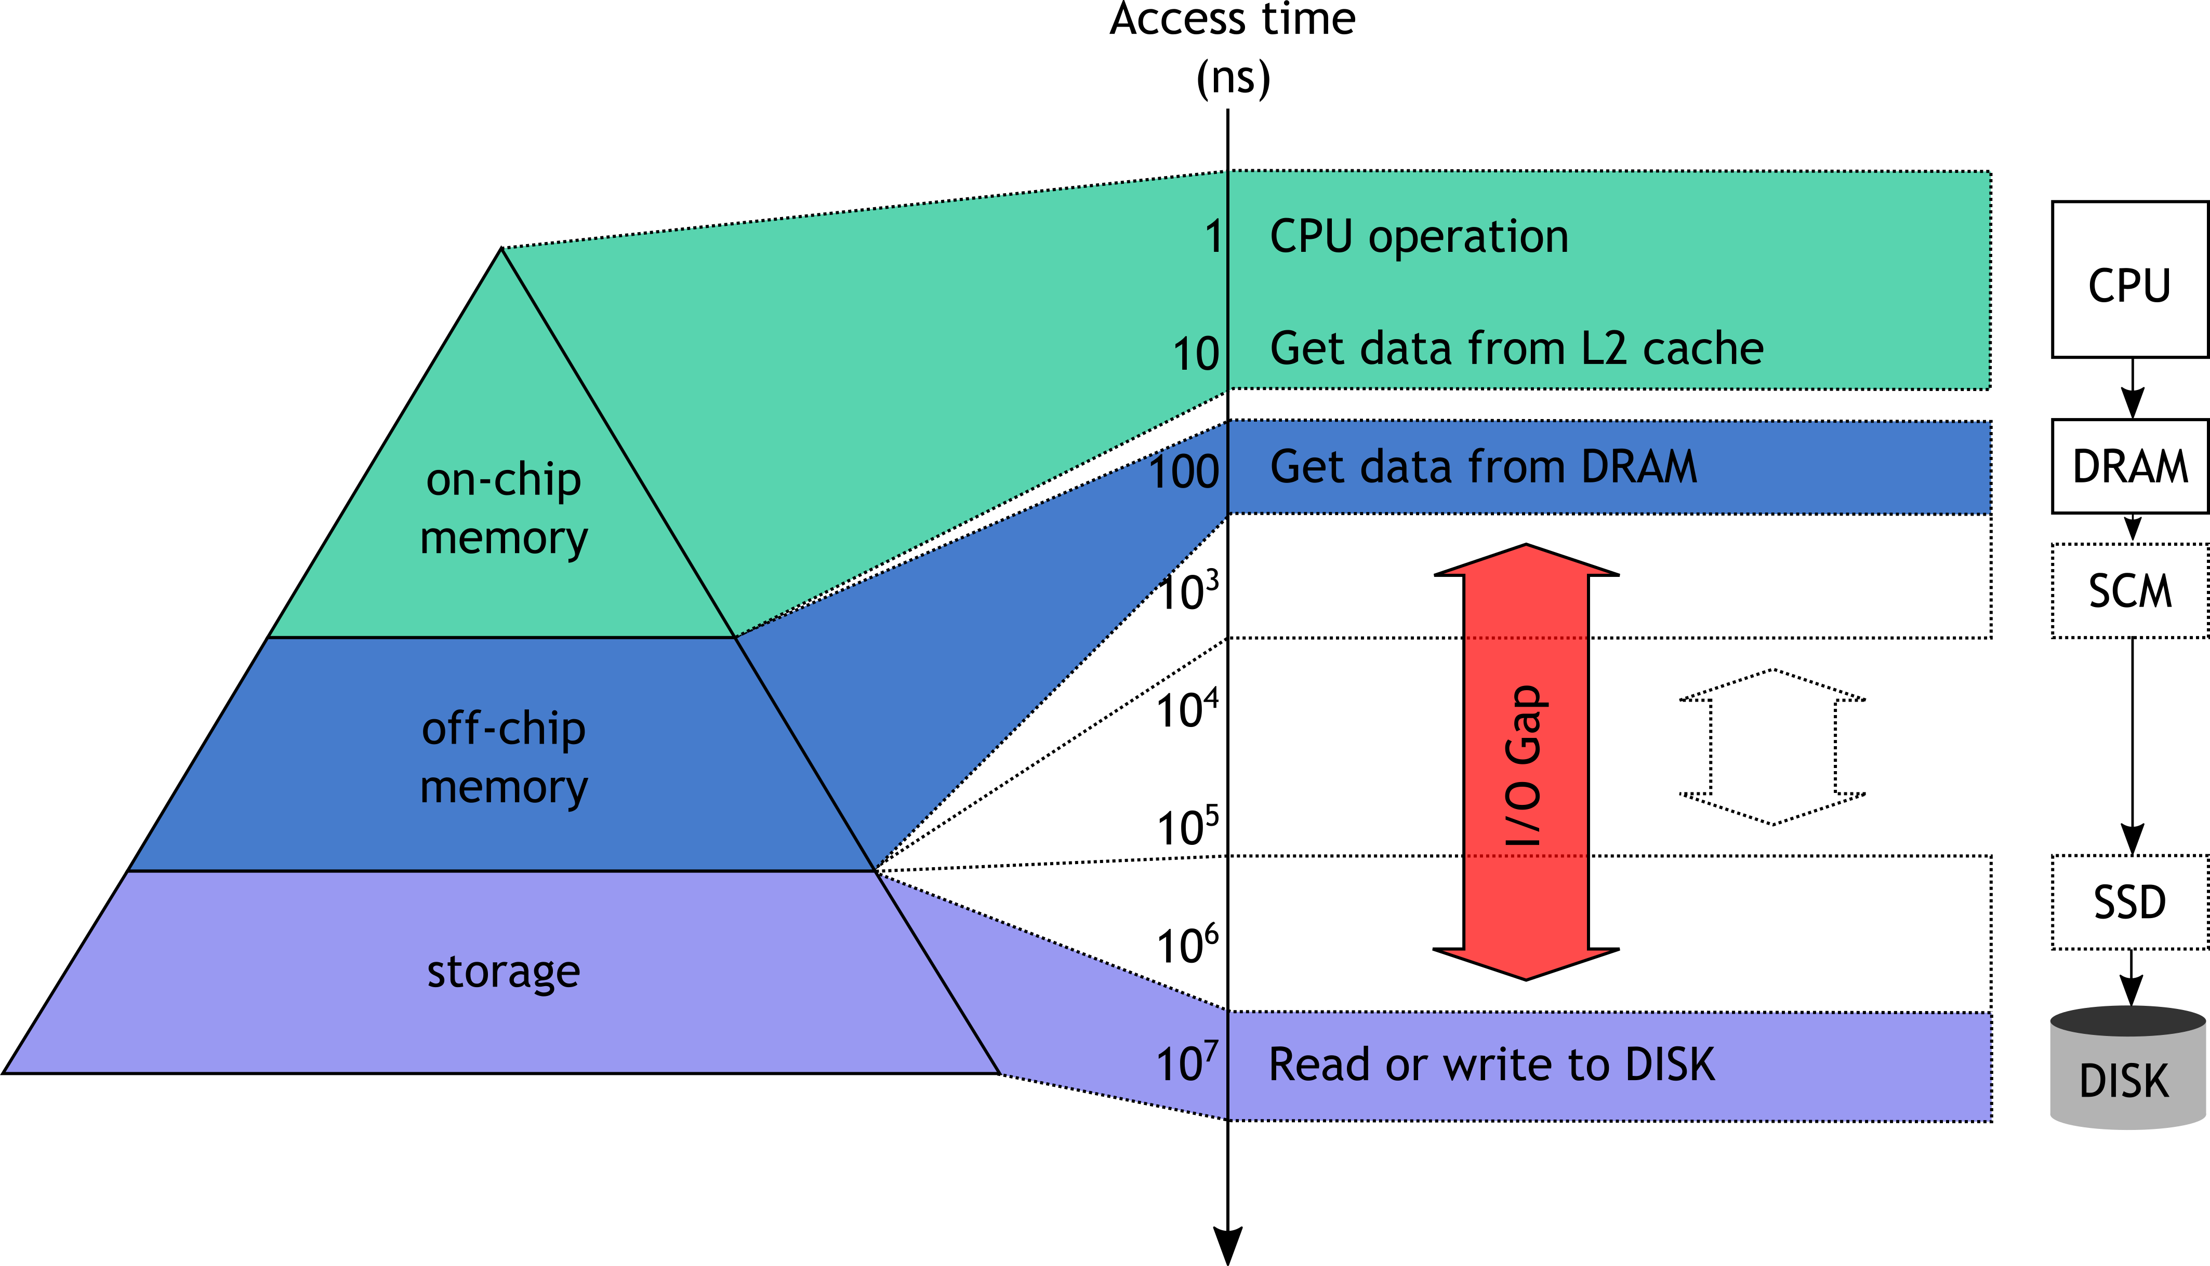
The I/O Gap Problem
Increasing performance gap between data access and compute
Storage becomes bottleneck
Notes:
For cost efficiency reasons, parallel file system are disk based and limit the use of faster and more expensive storage technology (like SSDs) to a limited subset of data and metadata. Unfortunately, as we can see from the diagram, HDDs are many orders of magnitude slower than CPUs. This causes accesses to data in the file system to stall applications for a considerable amount of their run-time. Additionally, the performance gap between CPUs and HDDs has been increasing steadily for many years and things are not improving with the release of many integrated core architectures like KNC and KNL and accelerators like GPGPUs and FPGAs.

Slide 5
Hierarchical Memory & Policies
Hiding I/O Latency
Read Accesses
Readahead: exploit space locality to preload data from disk into cache
LRU: exploit time locality to keep most valuable data in cache
Write Accesses
Write-behind: temporarily store data into cache and write it to disk asynchronously later on
HPC I/O patterns are complex
Application
Cache
File System
Notes:
Historically engineers have addressed the performance gap between CPU and Memories by inserting smaller but faster cache memories in between, thus building a memory hierarchy in which accesses to fast caches can, under certain conditions, hide the latency of slower but larger memories. For HDDs the same technique is implemented using the system DRAM as cache. In Linux this cache is called Page Cache.
Caching exploits some intrinsic property of I/O patterns, namely temporal and spatial locality of reference. That means that data accessed most recently (or spatially close to accessed data) has a higher chance to be accessed again or to be referenced again in the future. Therefore, it is beneficial if this data is kept in cache to minimize the performance penalty of accessing it from the HDD. Likewise, temporal locality means that more recent data has higher probability of being accessed than older data.
Spatial locality of references is exploited to implement read-ahead strategies that prefetch data from the HDD into DRAM in an effort to predict the future. Temporal locality of references is exploited to implement cache replacement strategies that prioritize the retention of most recently used data (LRU). Unfortunately, such simple heuristic don’t work for HPC applications that have more complex access patterns.
For write patterns the cache can also be used to buffer stores so that applications can return to computation faster while data is transferred from cache to disk asynchronously. However, cache have reduce capacity and cannot accommodate large datasets.

Slide 6
Agenda
Guided Prefetching
Research Landscape on I/O Prefetching
File System Prefetching Interfaces
Mercury Middleware
Evaluation
NVM Write Behind Caching in MPI I/O
Parallel I/O in MPI
Extended two phase algorithm
Research Landscape on Collective I/O
Non-Volatile Based Approach
Evaluation
Conclusions
Notes:
In this thesis we have focused on well known caching techniques and tried to adapt them to the HPC world to improve application’s performance. In the first part I will discuss our approach for Analytics applications that are predominantly read oriented and how we can improve performance using GUIDED I/O interfaces.
In the second part of the presentation I will talk about simulation codes that are predominantly write oriented and need to save their computational context to persistent storage in order to be able to recover from system failures.

Slide 7
Guided Prefetching in Linux
Notes:
This slide is to explain what the small I/O problem is about in shared files

Slide 8
Research Landscape on I/O Prefetching
Static
(compiler inserted
hints)
Speculative
(source-to-source or
binary modification)
Dynamic
(history based)
Manual
(user inserted)
Notes:
There exist different approaches to prefetching, each targeting a different type of behaviour.
Mowry et al. “Automatic compiler-inserted i/o prefetching for out-of-core applications”
Brown et al. “Compiler based i/o prefetching for out-of-core applications”
Tran and Reed “Automatic arima time series modeling for adaptive i/o prefetching”
He et al. “I/O acceleration with pattern detection”
He et al. “Knowac: I/O prefetch via accumulated knowledge
Chang and Gibson: “Automatic hint generation through speculative execution”
Chen et al. “Hiding i/o latency with pre-execution prefetching for parallel applications”
Patterson et al. “Informed prefetching and caching
VanDeBogart et al. “Reducing seek overhead with application-directed prefetching”

Slide 9
Contributions
Manual approaches have best performance
Applications developers lack I/O expertise
Administrators understand I/O but lack access to the source code
Develop framework for I/O pattern optimizations
Work with new and existing interfaces and applications with minor or no modifications
Provide global scope

Slide 10
Guided I/O Interfaces – POSIX
int posix_fadvise(int fd, off_t offset, off_t len, int advice)
POSIX_FADV_NORMAL | Sequential Mode (defaults)
POSIX_FADV_SEQUENTIAL | Sequential Mode + Bigger Readahead
POSIX_FADV_RANDOM | Random Mode (Disable Readahead)
POSIX_FADV_WILLNEED | A file region will be needed
POSIX_FADV_DONTNEED | A file region will not be needed
POSIX_FADV_NOREUSE | Not Implemented

Slide 11
Guided I/O Interfaces – GPFS
int gpfs_fcntl(int fd, void *fcntlArgP)
gpfsAccessRange_t | Defines File Range to be Accessed
gpfsFreeRange_t | Defines File Range to be Released
gpfsMultipleAccessRange_t | Defines Multiple File Ranges to be Accessed
gpfsClearFileCache_t | Releases All the Page Pool Buffers for a Certain File

Slide 12
Guided I/O Interfaces – Limitations
Vendor/System specific
No unified interface available
POSIX interface lacks flexibility
Sequential/Random advice apply to whole file
Advice apply locally (not network file system)
Interface is blocking
POSIX and GPFS interfaces lacks simplicity
User has to handle explicitly the prefetching and the release of file ranges
Understanding and using these interfaces is not trivial

Slide 13
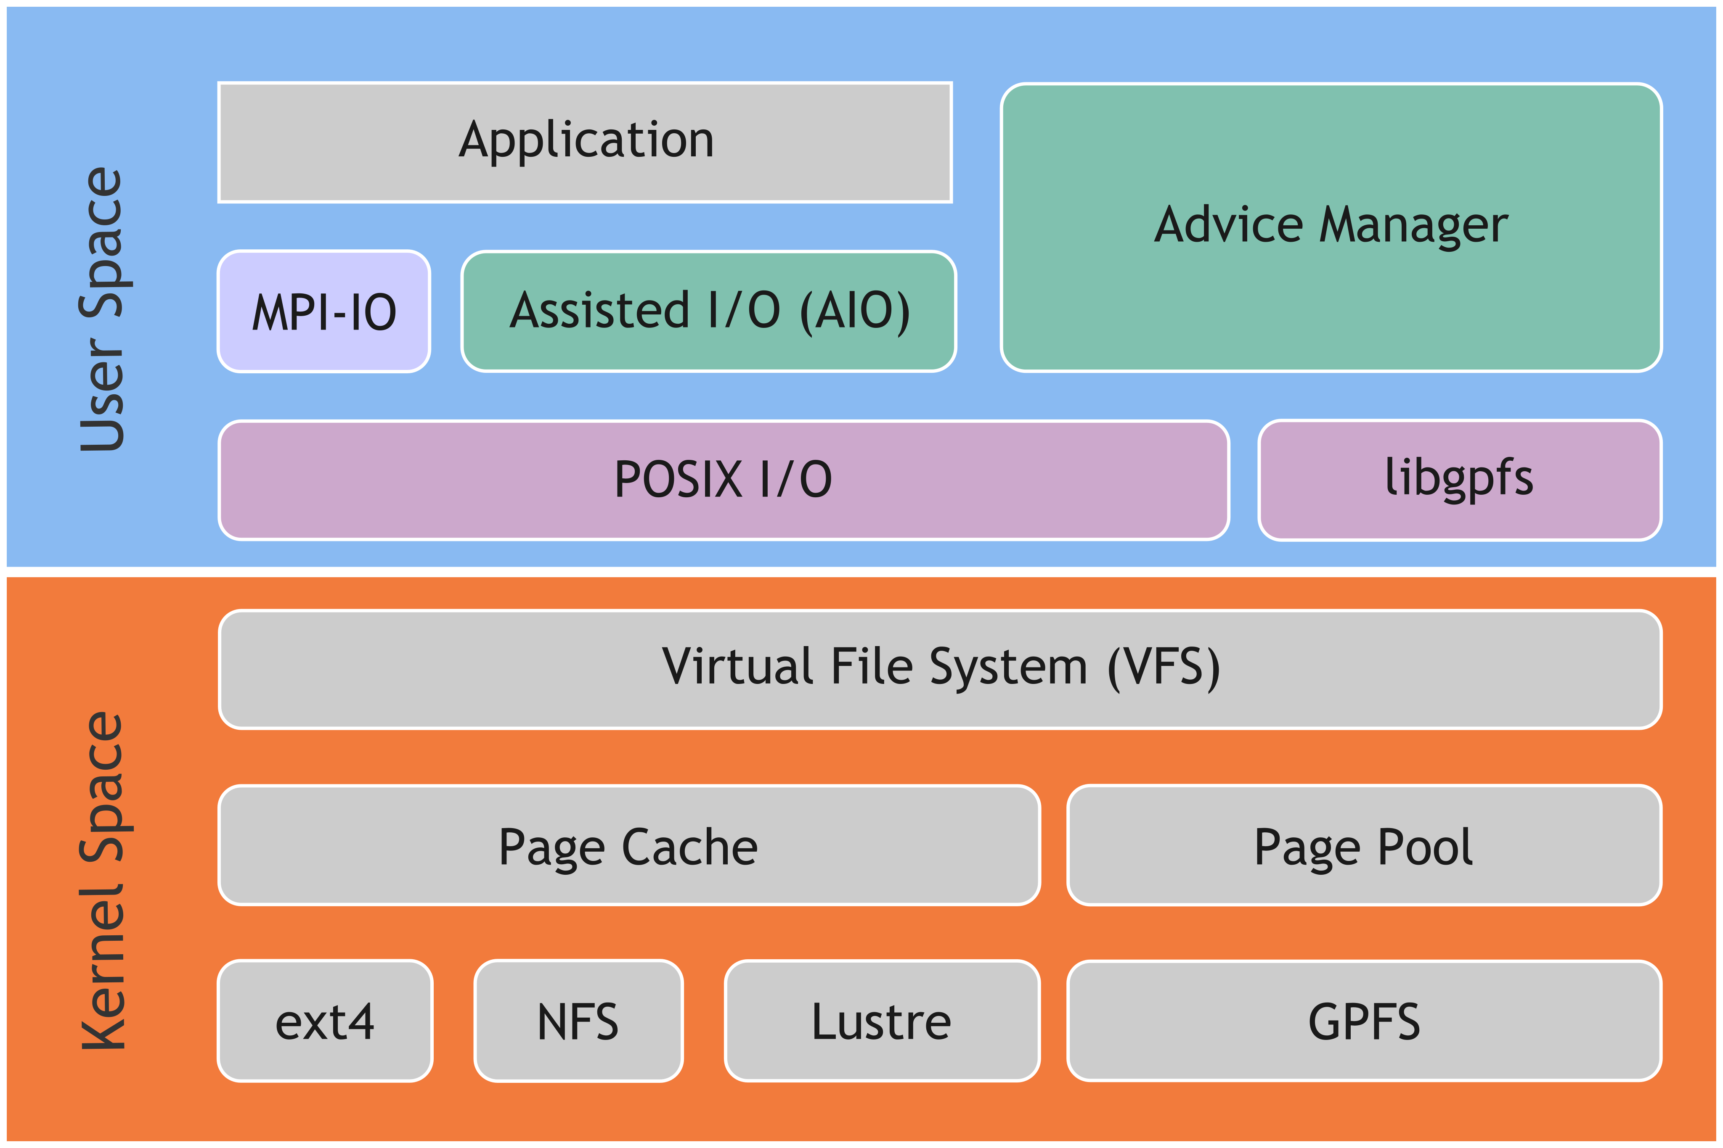
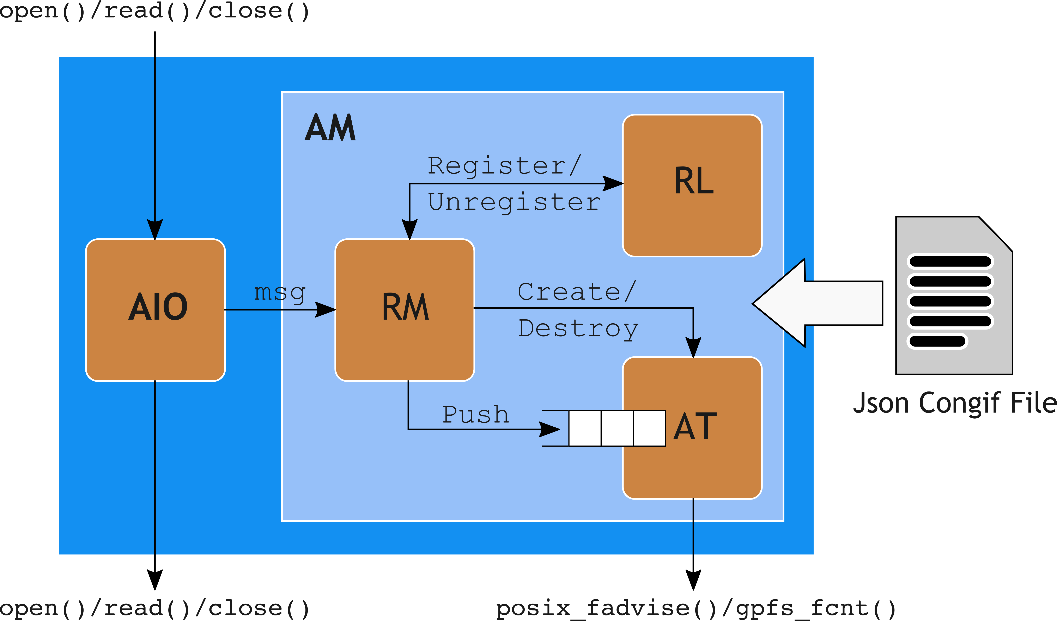
Mercury Design & Architecture
Requirements:
Uniform Interface
Flexibility
Non-blocking
Simplicity
Mercury:
Interposing Library (AIO)
Advice Manager

Slide 14
Mercury – LUSTRE Integration

Slide 15
Use Case: HEP ROOT Based Analytics Code
Read use case on the Mogon Cluster at University of Mainz
Run on GPFS (now IBM Spectrum Scale)
Root is one of the Major user of the Mogon Cluster
Access pattern look sequential
Apparently no room for improvement
However …

Slide 16
Use Case: HEP ROOT Based Analytics Code
Seeks and Small I/O non optimized for parallel file systems
Data not accessed by increasing offset: mix sequential and non-contiguous accesses with back ward seeks
Backward seek across many bytes (4-20 MBs)
Average request size varies from few bytes to several hundreds of bytes
{
“File”: {
“Path”: “/path/to/target/file”,
“BlockSize”: 4194304,
“CacheSize”: 2,
“ReadAheadSize”: 1,
“WillNeed”: {
“Offset”: 0,
“Length”: 0
}
}
}
~ 30%

Slide 17
Evaluation – Testbed
Custom Cluster at ZDV
4 Compute Nodes and 1 Metadata Server (MDT)
8 core processor @3.3 GHz with 16 GB of RAM
1 Object Storage Target (OST) and1 Network Shared Disk (NSD)
Dual socket 4 core processor @2.4 GHz and 24 GB of RAM
Storage System
4 disk expansion shelves with 15 disk each (60 2TB drives in total)
4 disk pools configured in RAID 8+2
128 KB file system block size (1 MB RAID stripe size)

Slide 18
Evaluation – Runtime vs File Size
~ 10%
~ 33%
Mercury Configuration
BlockSize = 4 MB
CacheSize = 8 blocks
ReadAheadSize = 4 blocks
~ 50%

Slide 19
Evaluation – Operations/s vs File Size
20%
> 50%
Mercury Configuration
BlockSize = 4 MB
CacheSize = 8 blocks
ReadAheadSize = 4 blocks
50%

Slide 20
Evaluation – Runtime vs # App Instances
~ 30%
Mercury Configuration
BlockSize = 4 MB
CacheSize = 8 blocks
ReadAheadSize = 4 blocks

Slide 21
Evaluation – Ops/s vs # App Instances
> 50%
Mercury Configuration
BlockSize = 4 MB
CacheSize = 8 blocks
ReadAheadSize = 4 blocks
> 50%

Slide 22
NVM Write Behind Caching in MPI I/O

Slide 23
I/O for Scientific Codes
Save context for defensive checkpoint restart
N Processes read/write from/to N independent files (N-N)
Pros: straight forward; Cons: hard to manage many small files
N Processes read/write from/to 1 shared file (N-1)
Pros: simple to manage; Cons: performance penalties for enforcing data consistency!
Node 0
Node 1
Node 2
Node 3
Node 0
Node 1
Node 2
Node 3
Processes
File
System
File
N-N
N-1
23

Slide 24
Legacy Workaround with POSIX I/O
Legacy workaround → offload I/O to one process
Provide I/O proxy global scope (enable global optimizations) 👍
Avoid block contention and locking (only 1 process accesses file) 👍
I/O proxy becomes bottleneck (no parallel I/O, no scaling) 👎
Often application specific (not portable) 👎
As we will see MPI I/O builds on this to provide a scalable solution
Node 0
Node 1
Node 2
Node 3
Node 0
Node 1
Node 2
Node 3
File
24

Slide 25
Why MPI I/O?
POSIX I/O was originally designed for single node
Every process issues independent I/O calls (no collectives)
Interface cannot capture global I/O scope (no global optimizations possible)
Strong consistency semantics imposes scalability issues
MPI I/O provides high performance I/O through:
Enriched I/O semantics able to convey global scope
Scalable I/O (group operations at library level to reduce file system I/O calls)
Weaker consistency semantics (avoid locks → serialization)
Portable I/O interfaces
25

Slide 26
Collective I/O in ROMIO: Concept
Many independent non-contiguous accesses cause poor I/O performance (disk seek & block lock contention)
Exploit global knowledge exposed by MPI I/O semantics to convert many small requests into a few large requests to present to the file system
Trade increased communication for better disk access
Node 0
Node 1
Node 2
Node 3
MPI I/O library
File
Data Servers

Slide 27
Extended 2 Phase Algorithm (1/2)
Collective I/O uses extended two phase (ext2ph) algorithm
A subset of processes accesses the file (aggregators)
Aggregators access non-overlapping portions of the file (file domains)
I/O is carried out in two phases (consider writes, reads are inverted)
Communication phase: all processes send data to aggregators
I/O phase: aggregators write data to their file domains indepently
Eventually every process syncs to make sure it is safe to reuse buffers
If the file domain is large, multiple round of two phase I/O are required
Node 0
Node 1
Node 2
Node 3
File
Data Servers

Slide 28
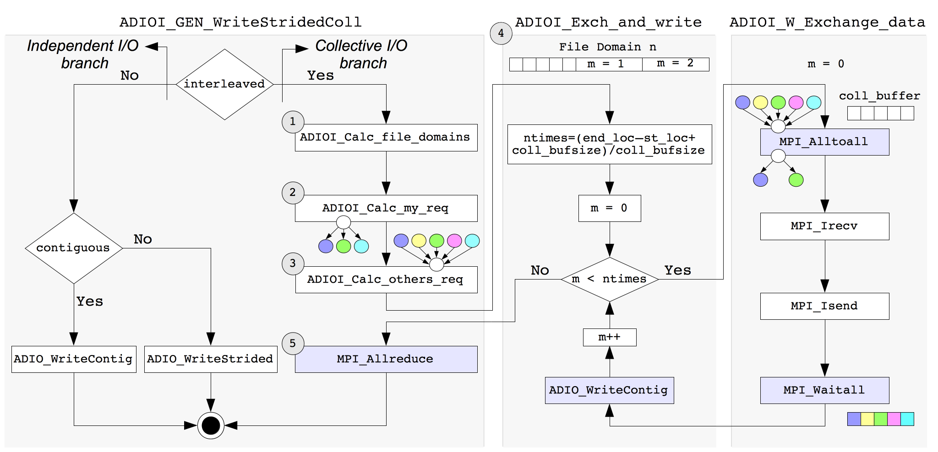
Extended 2 Phase Algorithm (2/2)
MPI_Allreduce() and MPI_Alltoall() account for global synchronisation time
MPI_Waitall() accounts for send/recv time
ADIO_WriteContig() accounts for write time

Slide 29
Research Landscape on Collective I/O
File System
Stripe Contention
Logical to Physical
Layout Mismatch
Global
Synchronization
Overhead
Memory
Pressure
Network
Concurrency
Notes:
Stripe contention
File system lock protocol:

Slide 30
Contributions
Parallel I/O scalability problems
Global synchronization overhead (PFS)
Memory pressure on aggregators (ext2ph)
Proposed solution
Take parallel file system out of critical path
Use SSDs to improve aggregate I/O bandwidth

Slide 31
NVM Integration in MPI I/O (1/2)
Developed in the thesis in the context of the DEEP-ER project and tested on DEEP Cluster
New MPI-IO Hints
e10_cache
e10_cache_path
e10_cache_flush_flag
e10_cache_discard_flag
e10_cache_threads
Global Sync Group (MPI_COMM_WORLD)
Processes
0
1
2
3
4
5
Buffers
MPI-IO
Collective
Buffers
ADIO (Abstract Device IO)
Collective I/O
ROMIO
Lustre
Driver
GPFS
Driver
UFS
Driver
BeeGFS
Driver
DEEP-ER
Cache
Independent
I/O
Common Layer (DEEP-ER Cache)
Parallel
File System
Parallel File System

Slide 32
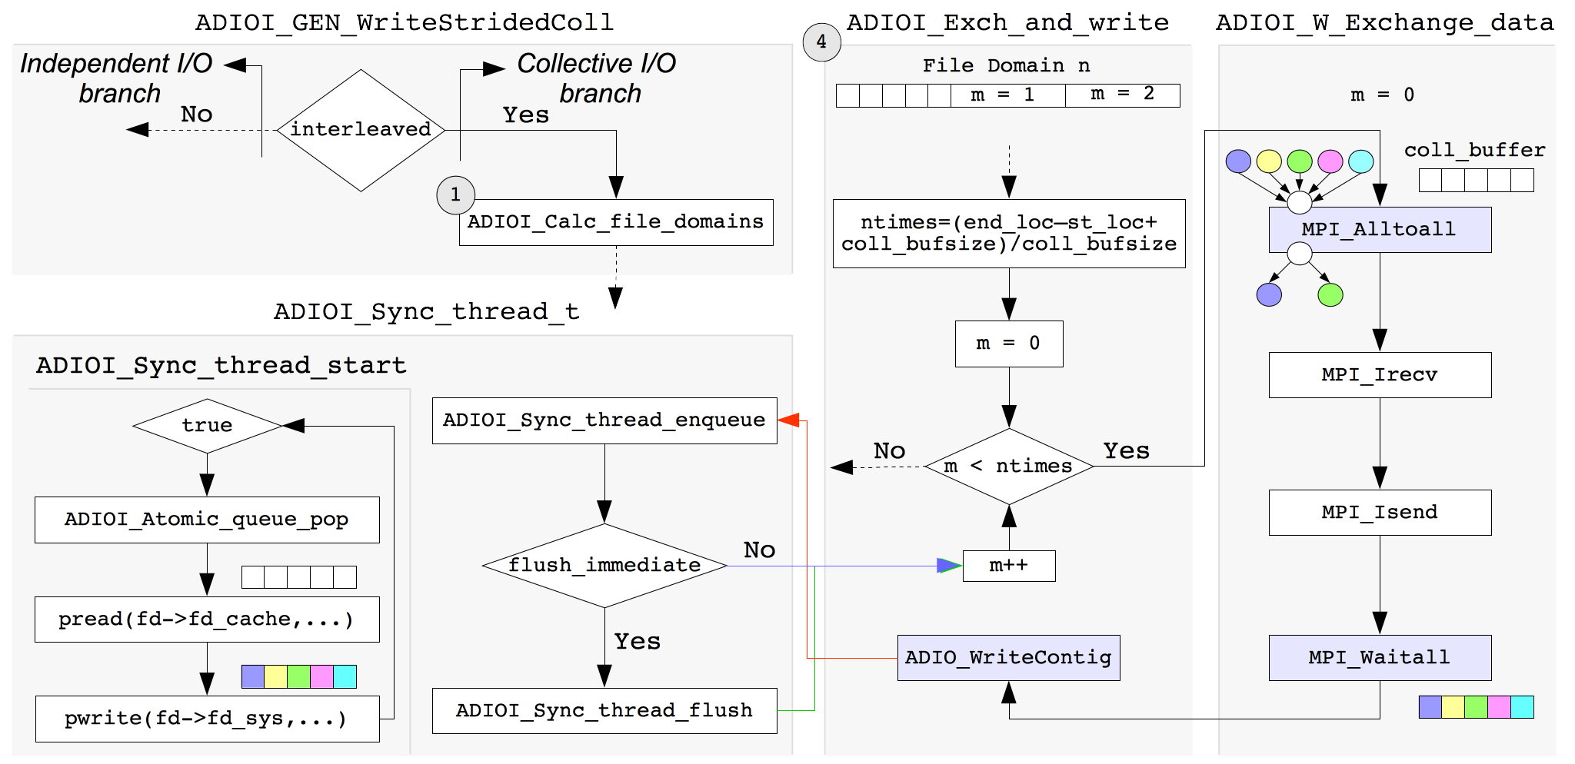
NVM Integration (2/2)
ADIOI_Sync_thread_t: object containing sync thread implementation
ADIOI_Sync_thread_start: sync routine

Slide 33
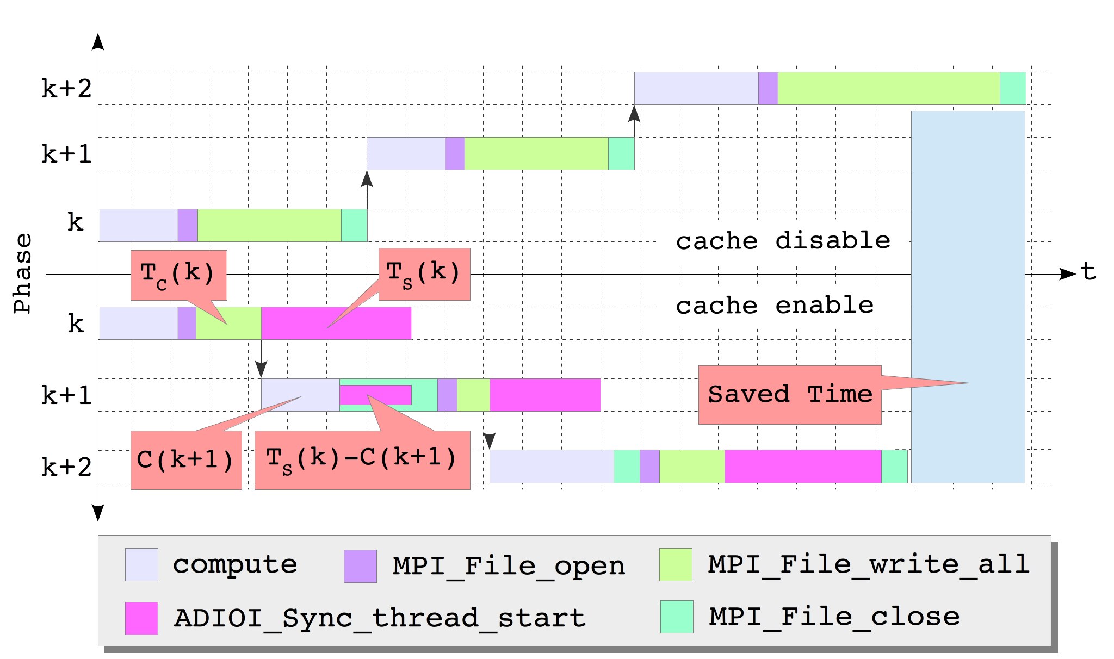
Modified Workflow
S(k): amount of data written to the file at phase k
T_{c}(k): time to write S(k) to the cache
T_{s}(k): time to sync S(k) with the parallel file system
C(k): compute time at phase k

Slide 34
Evaluation – Testbed
DEEP Cluster
128 Compute Nodes
2 Xeon CPUs (8 cores per CPU)
32 GB of RAM
80 GB of Commodity SATA SSD
6 Storage Servers (Dell Power Edge R520)
2 Xeon CPUs (4 cores per CPU)
32 GB of RAM
1 MDS, 1 MGM Server, 4 I/O Servers
1 SGI JBOD, 45 2TB SAS Drives (8+2 RAID 6)
BeeGFS with 4 MB stripe size and 4 stripe count

Slide 35
Evaluation – Coll_perf (1/2)
512 processes (8/node) writing a 32GB (64 MB per proc) shared file varying # of
aggregators and collective buffer size
Cache Disable
TBW represents the maximum theoretical bandwidth achievable when writing to the cache without flushing it to the parallel file system
Notes:
Point out
Decreasing synchronization and write time with coll buff size
Increasing communication with coll buff size
Increasing synchronization with more aggregators

Slide 36
Evaluation – Coll_perf (2/2)
512 processes (8/node) writing a 32GB (64 MB per proc) shared file varying # of
aggregators and collective buffer size
Cache Enable
TBW represents the maximum theoretical bandwidth achievable when writing to the cache without flushing it to the parallel file system
Notes:
Point out
Constant write cost
Decreasing sync cost

Slide 37
Evaluation – Flash I/O (1/2)
512 processes (8/node) writing a ~30 GB (768 KB/proc/block, 80 blocks/proc) shared file
varying # of aggregators and collective buffer size
Cache Disable
TBW represents the maximum theoretical bandwidth achievable when writing to the cache without flushing it to the parallel file system
Notes:
Point out that communication overhead cost is reduced compared to previous case because the amount of data exchanges is much less

Slide 38
Evaluation – Flash I/O (2/2)
512 processes (8/node) writing a ~30 GB (768 KB/proc/block, 80 blocks/proc) shared file
varying # of aggregators and collective buffer size
Cache Enable
TBW represents the maximum theoretical bandwidth achievable when writing to the cache without flushing it to the parallel file system

Slide 39
Evaluation – IOR (1/2)
512 processes (8/node) writing a 32GB (8 MB blocks per 8 segments) shared file varying
# of aggregators and collective buffer size
Cache Disable
TBW represents the maximum theoretical bandwidth achievable when writing to the cache without flushing it to the parallel file system
In IOR the last write sync phase is not overlapped with any computation and thus it is affecting the overall bandwidth performance

Slide 40
Evaluation – IOR (2/2)
512 processes (8/node) writing a 32GB (8 MB blocks per 8 segments) shared file varying
# of aggregators and collective buffer size
Cache Enable
TBW represents the maximum theoretical bandwidth achievable when writing to the cache without flushing it to the parallel file system
In IOR the last write sync phase is not overlapped with any computation and thus it is affecting the overall bandwidth performance

Slide 41
Conclusions

Slide 42
Mercury middleware for improved I/O prefetching
User knowledge can be exploited to guide transparent prefetching
History base prefetching potentially possible
NVM caching extensions to ROMIO
Compute nodes’ attached NVMs can improve collective I/O performance
Increase aggregate I/O bandwidth
Reduce global synchronization overheads in ext2ph
Reduce collective I/O memory requirements

Slide 43



Thank you for your attention!

